Slide 1

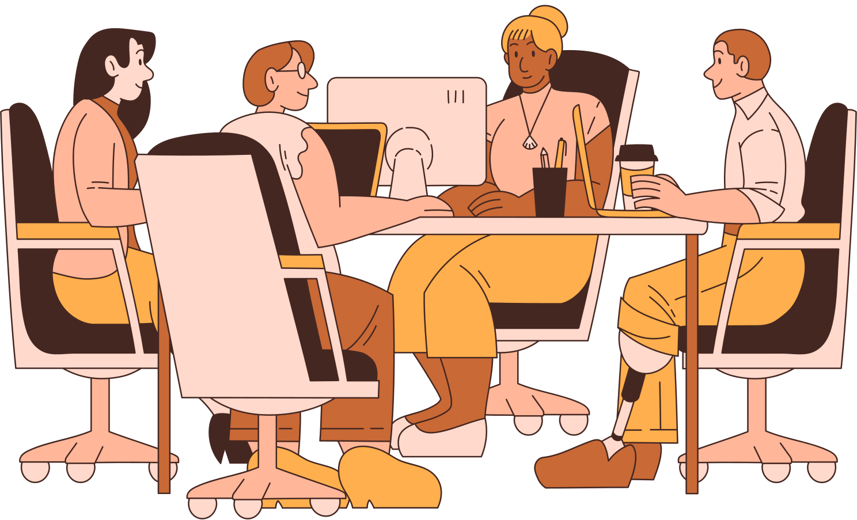

AUTONOMY AT WORK

Slide 2

CONTENT
Definition
The importance of autonomy
The way to build trust with coworkers

Slide 3
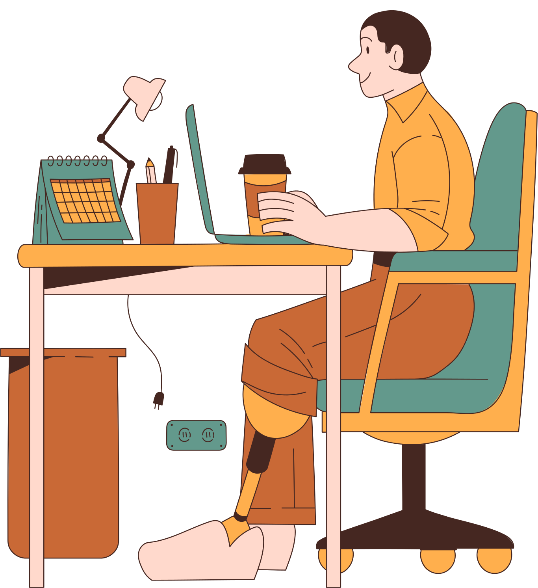
THE DEFINITION OF AUTONOMY IN THE WORKPLACE
The degree of independence and freedom that employees have in performing their tasks, making decisions, and managing their work

Slide 4

THE IMPORTANCE OF AUTONOMY IN THE WORKPLACE
Increase Job Satisfaction
Higher Motivation
Enhanced Creativity and Innovation
Improved Problem-Solving Skills
Flexibility and Work-Life Balance
Attraction and Retention of Talent
Adaptability to Change

Slide 5

THE WAY TO BUILD TRUST WITH COWORKERS
LEAD BY EXAMPLE
COMMUNICATION
CONSISTENCY
Demonstrate trustworthiness through actions and decisions
Foster clear and open communication
Follow through on commitments and deadlines to establish reliability.

Slide 6

THE WAY TO BUILD TRUST WITH COWORKERS
SHARING INFORMATION
EMPOWERMENT
RESPECT
Share relevant information openly and proactively.
Empower the colleagues by trusting them with responsibilities and decision-making.
Treat the coworkers with respect and kindness.

Slide 7

THE WAY TO BUILD TRUST WITH COWORKERS
ACCOUNTABILITY
SET REALISTIC EXPECTATIONS
CONFLICT RESOLUTION
Briefly elaborate on what the subtopic is all about.
Clearly define expectations and goals for requirements.
Encourage open dialogue to resolve issues and misunderstandings.

Slide 8
THE WAY TO BUILD TRUST WITH COWORKERS
RECOGNIZE ACHIEVEMENTS
PROVIDE SUPPORT
PROMOTE INCLUSIVITY
Recognize and reward hard work and dedication.
Offer support to colleagues during challenging times.
Ensure that everyone feels included and valued.

Slide 9
THE WAY TO BUILD TRUST WITH COWORKERS
ENCOURAGE FEEDBACK
TRAINING AND DEVELOPMENT
TEAM BUILDING ACTIVITIES
Use feedback as a tool for continuous improvement.
Support professional development to enhance the capabilities of the team.
Engage in team-building activities to strengthen relationships

Slide 10

THANK YOU FOR LISTENING!
If you have any questions, feel free to reach out to us through any of the following:
EMAIL ADDRESS
hoaithanhtrinh2002@gmail.com

